Slide 1
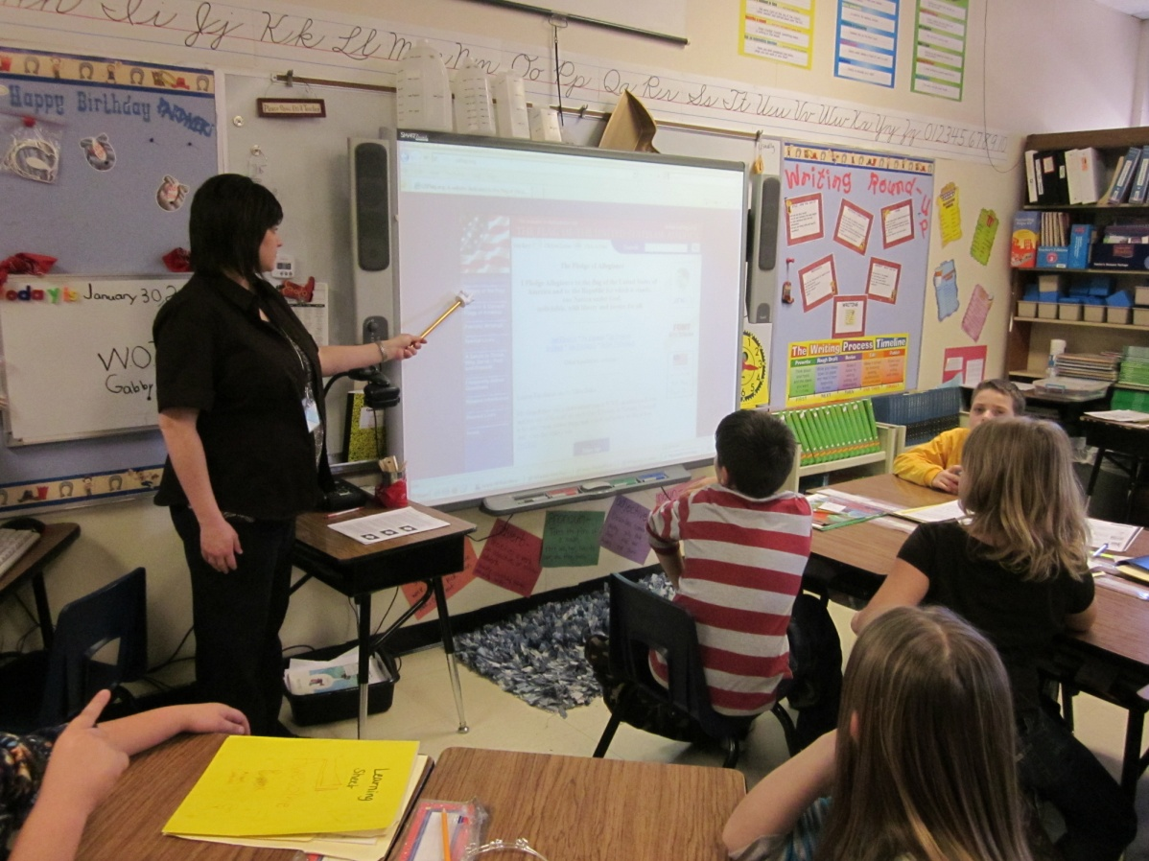
Researching the History of “Old Glory”
Mrs. Kendree Kilsch’s Third Grade Class
Grace Hill Elementary / Rogers, AR
February 7, 2012
Presentation by Anne Saullo, Literacy Facilitator

Slide 2
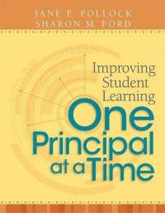
GANAG is a lesson structure that allows teachers to plan for student use of research based instructional strategies.
G= goal
A= access prior knowledge
N= new information
A= application
G= generalize the goal

Slide 3
Purpose of the GANAG Structure
To give students the opportunity to actively use the nine high-yield strategies:
(2) Identifying Similarities and Differences
(7) Cooperative Learning
(3) Summarizing and Note Taking
(8) Setting Objectives and Providing Feedback
(4) Reinforcing Effort and Providing Recognition
(9) Generating and Testing Hypotheses
(5) Homework and Practice
(10) Cues, Questions and Advance Organizers
(6) Nonlinguistic Representations

Slide 4
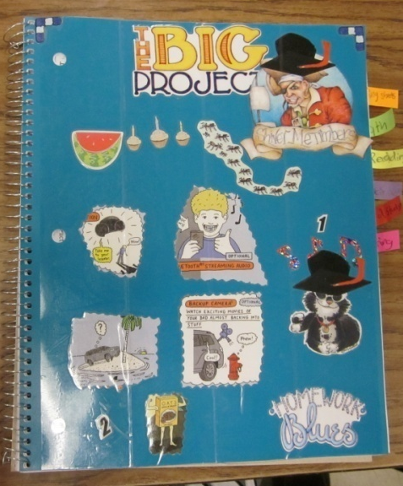
G= Goal
I can use the Internet to research.
Students were asked to score themselves.
Students used Student Scoring Sheets in their Interactive Notebooks to score themselves.
(8) Setting Objectives and Providing Feedback

Slide 5
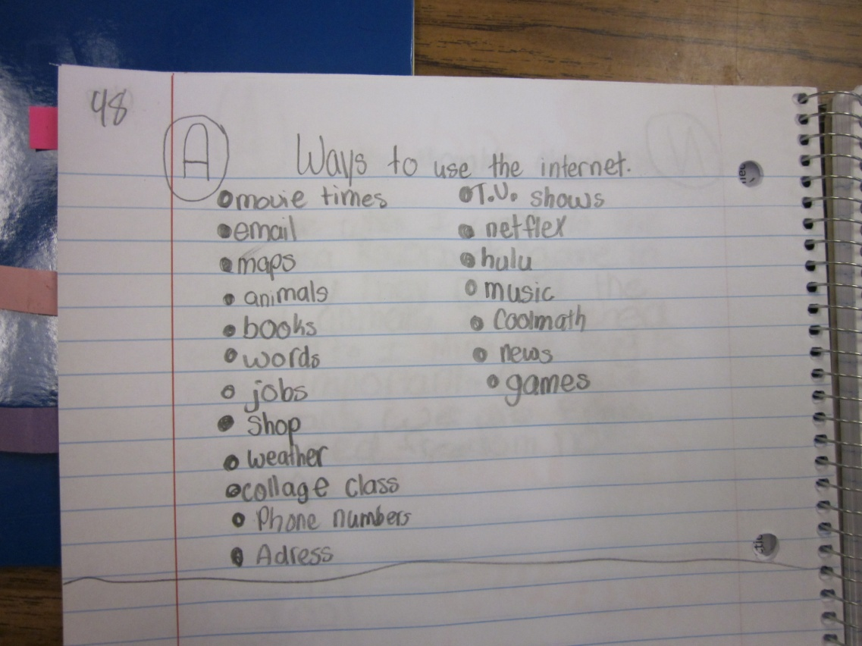
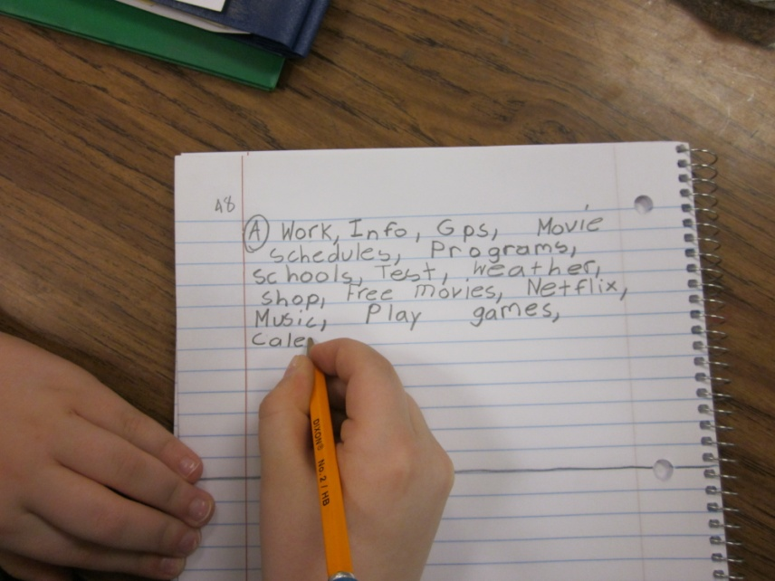
A= Access Prior Knowledge
Make a list of the types of information a person could get from the Internet.
(10) Cues, Questions and Advance Organizers

Slide 6
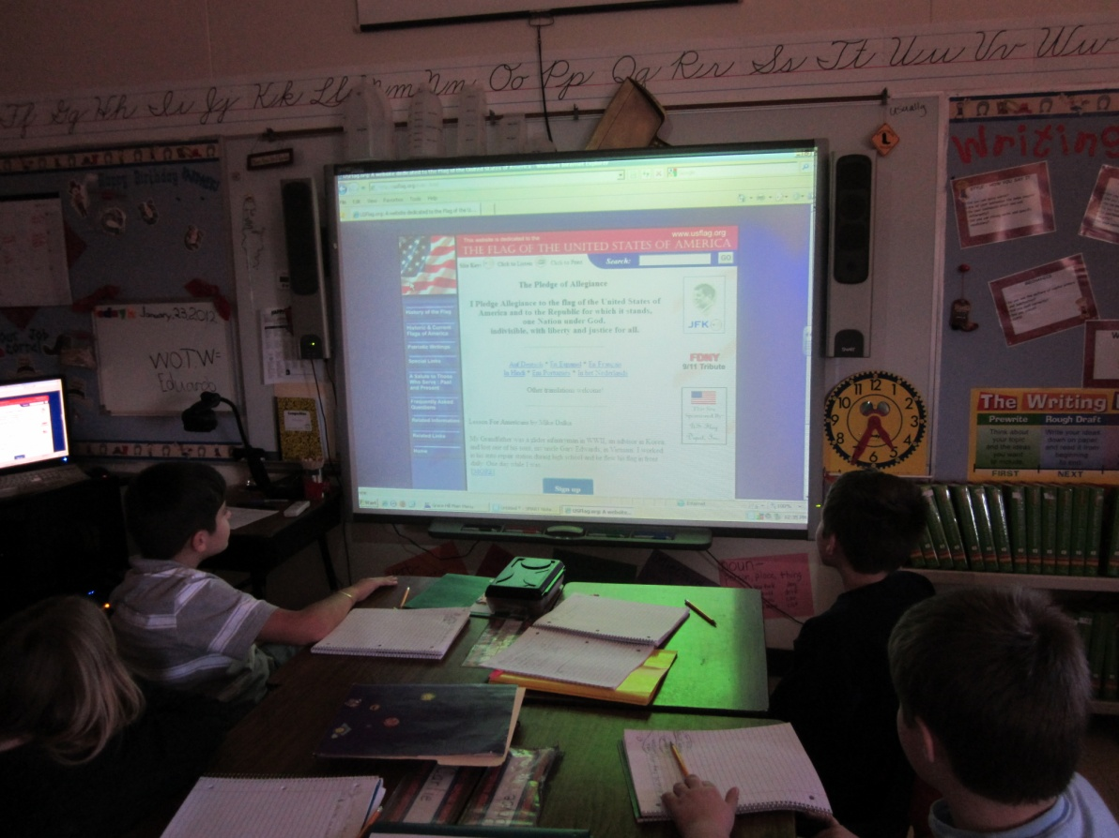
N= New Information
The website www.usflag.org was used to show students the layout of a typical website.
Students took notes in their Interactive Notebooks on how to get to and navigate the website.
(3) Summarizing and Note Taking

Slide 7
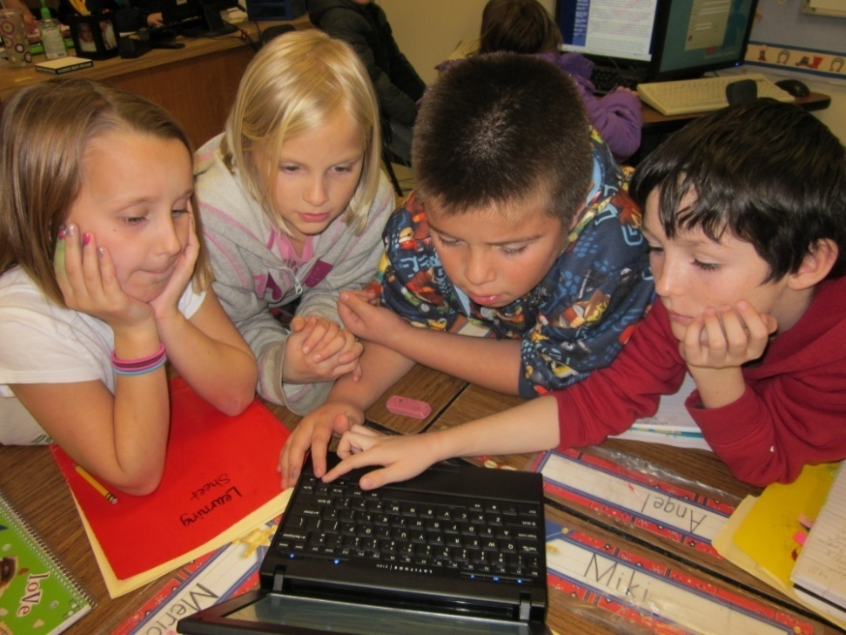
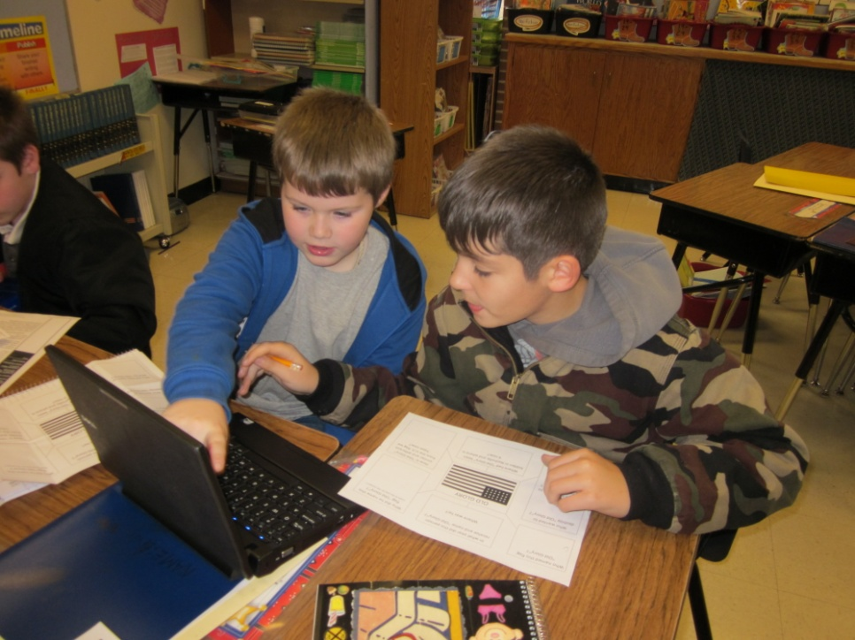
N= New Information
Students worked in groups to locate information on
the website to complete a graphic organizer.
(6) Nonlinguistic Representations
(7) Cooperative Learning
(5) Homework and Practice

Slide 8
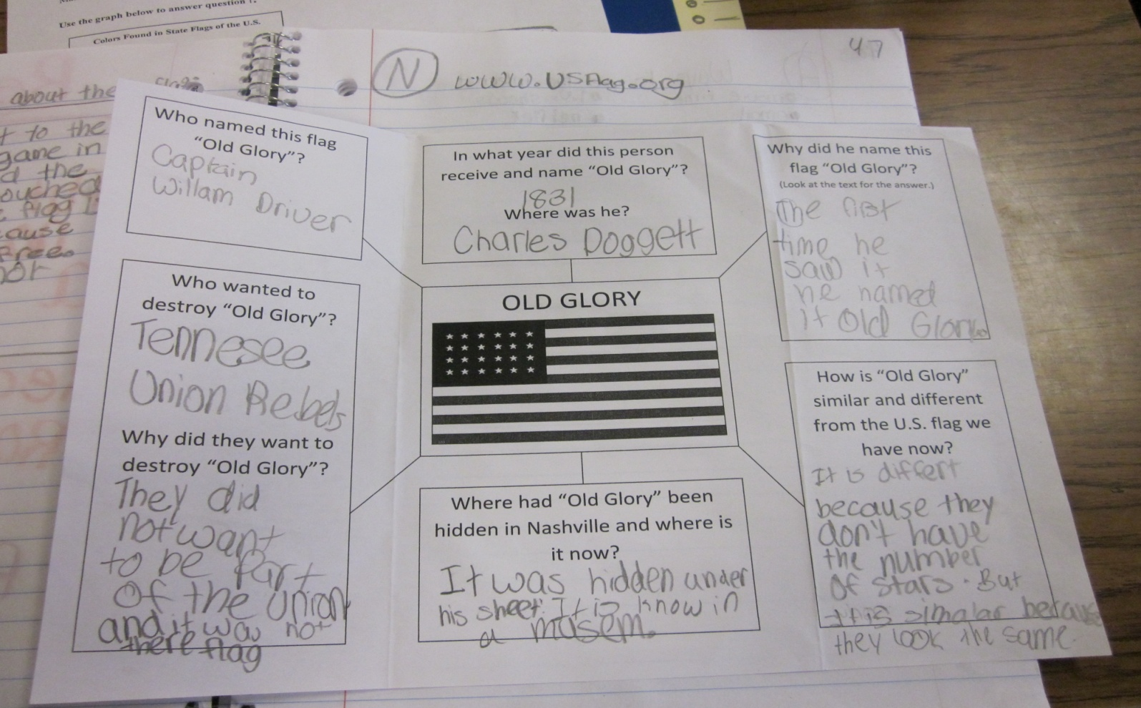
N= New Information
(3) Summarizing and Note Taking
Graphic Organizer
(6) Nonlinguistic Representations

Slide 9
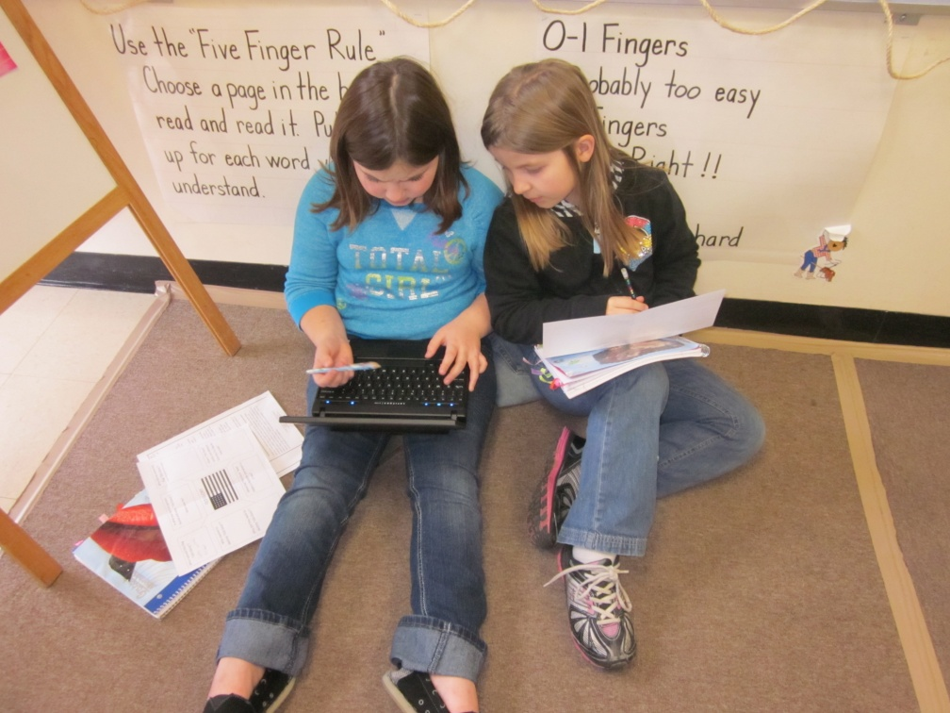
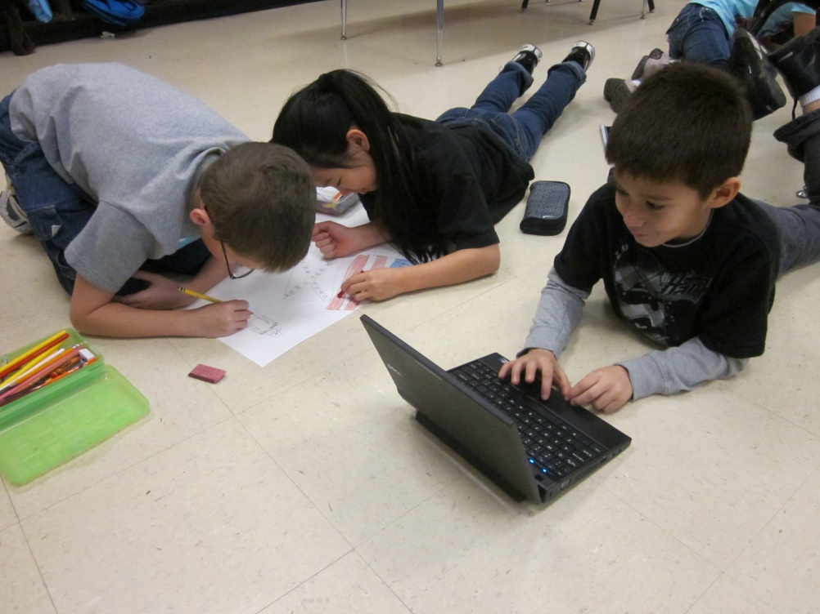
A= Apply Knowledge
Each group of students used the information to plan a
presentation on the history of “Old Glory.”
(7) Cooperative Learning

Slide 10
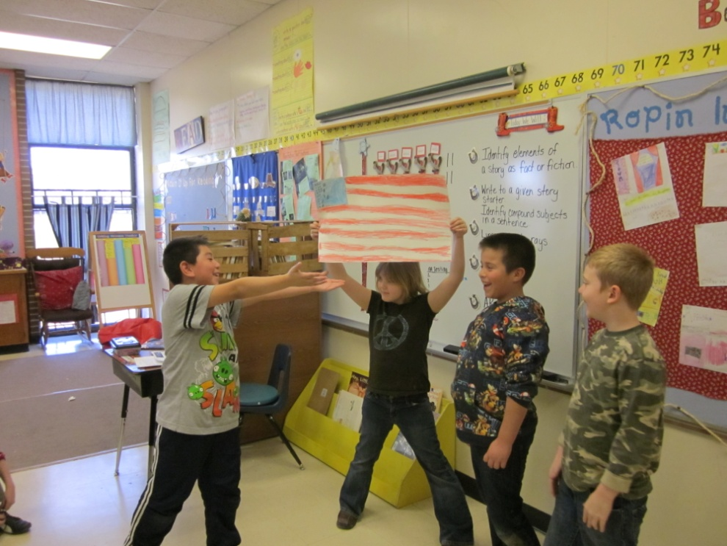
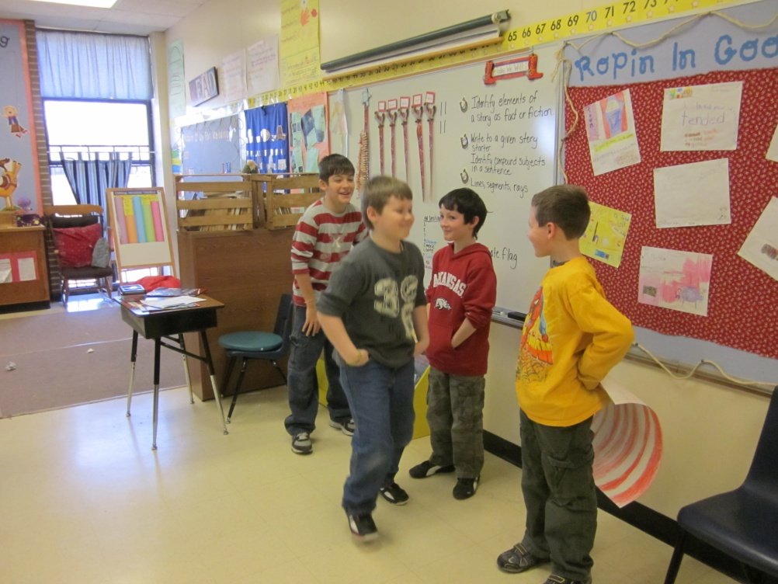
A= Apply Knowledge
Two groups of students planned and acted out a skit…
Showing how “Old Glory” got its
name.
Showing how “Old Glory” was
almost destroyed.
(7) Cooperative Learning

Slide 11
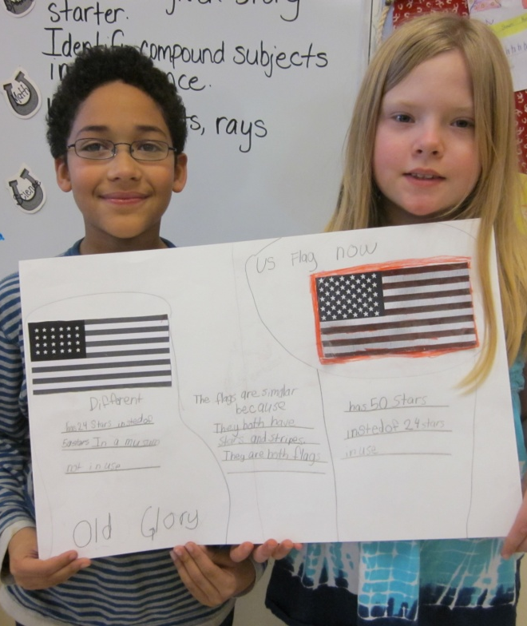
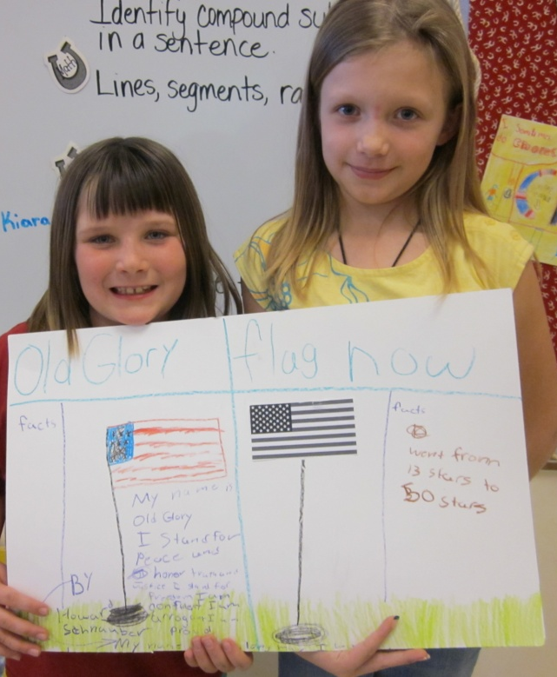
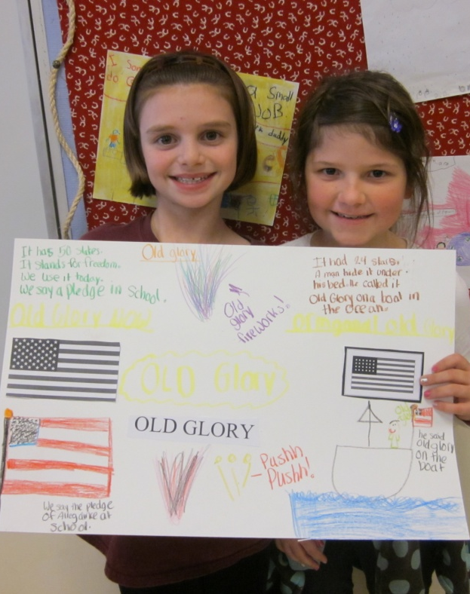
A= Apply Knowledge
Some students compared “Old Glory” to our current
U.S. flag.
(2) Identifying Similarities and Differences

Slide 12
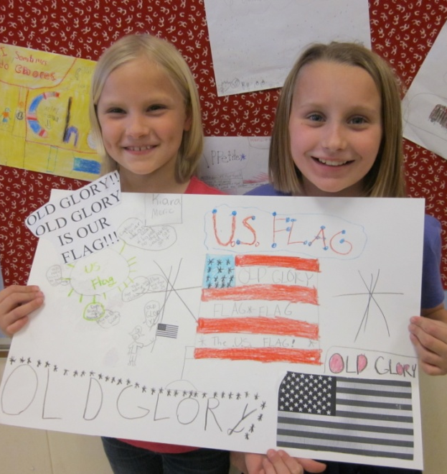
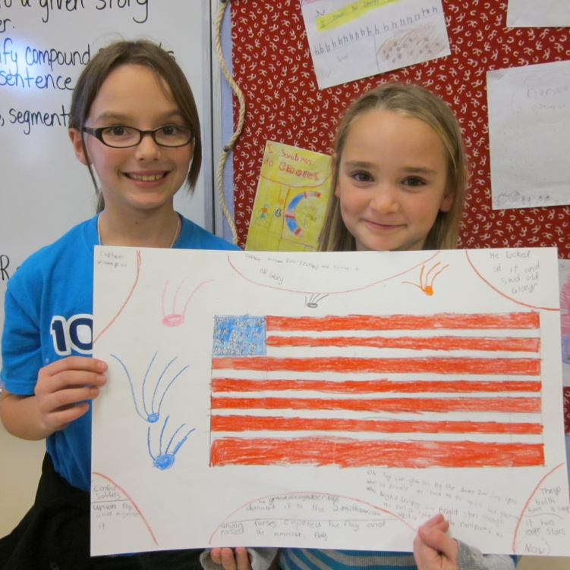
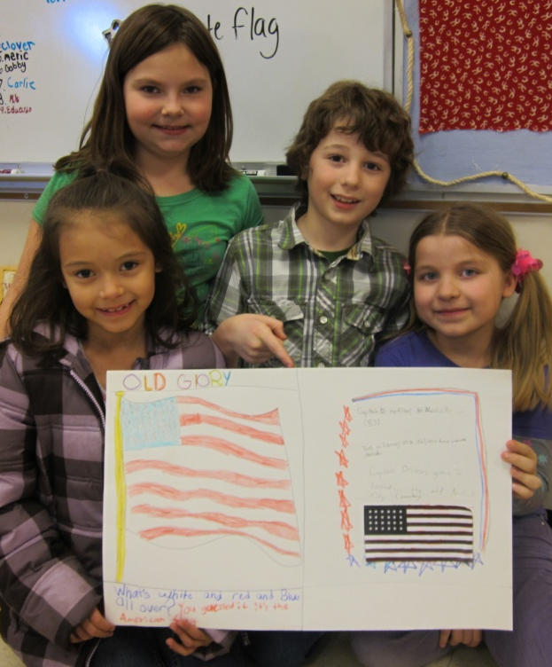
A= Apply Knowledge
Some students shared a poem or other information about “Old Glory.”
(2) Identifying Similarities and Differences

Slide 13
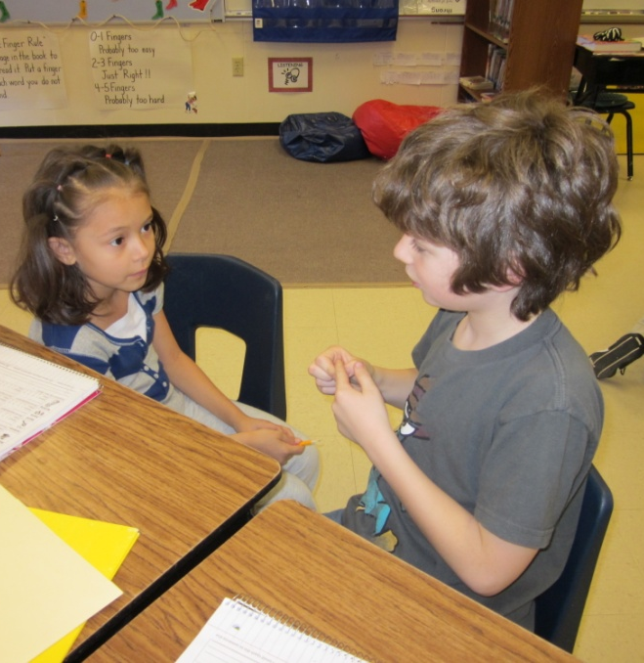
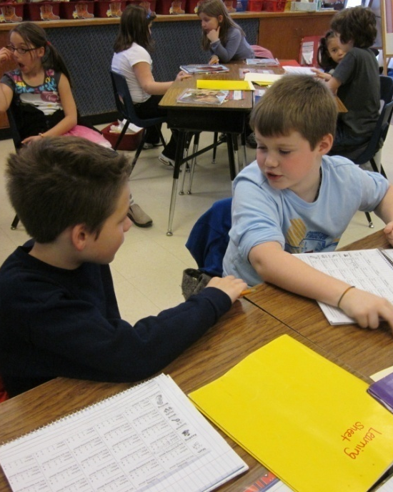
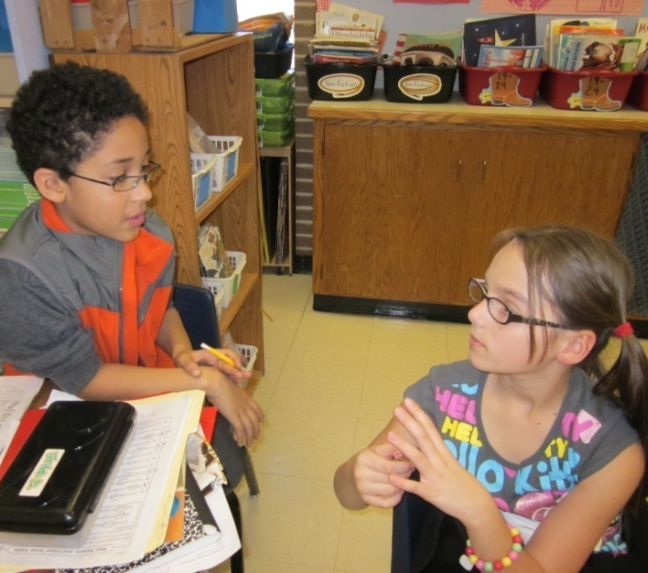
G= Generalize the Goal
Students turned and talked to revisit the goal, then
rescored themselves in their Interactive Notebooks.
(8) Setting Objectives and Providing Feedback

Slide 14
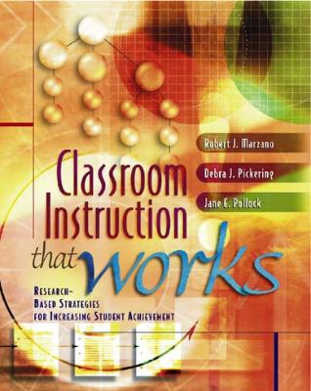
Marzano, R. J., Pickering, D. J., & Pollock, J. E. (2001). Classroom instruction that works: Research-based strategies for increasing student achievement. Alexandria, VA: Association for Supervision and Curriculum Development.
Pollock, J. E. (2007). Improving student learning one teacher at a time. Alexandria, VA: Association for Supervision and Curriculum Development.
Pollock, J. E., & Ford, Sharon M. (2009). Improving student learning one principal at a time. Alexandria, VA: Association for Supervision and Curriculum Development.

